Slide 1
USPC
ACTIVITY CHANGES
AND
INFO

Slide 2
Change of Nomenclature
No longer using the term qualifying or qualifying rallies---now called eligibility requirements
Now a Rally is either a Standard Rally or a Modified Rally
Standard Rally--- same as old qualifying rally
Follow discipline rulebooks for details.
Modified Rally
For Regions that can not for whatever reason meet criteria for Standard Rally
These competitors can then qualify for Modified Championship, but not Championship

Slide 3
2019 USPC Competition Divisions
Age is as of Jan 1 of competition year
Younger age divisions can always compete up to older age division.
Regional Rallies can combine divisions as the RS and Organizer find appropriate
Note:
Jr and senior teams can mix divisions (always been the case)
Ex: Training level dressage division can have Jr and Sr teams complete against each other
Not to mix Jr and Sr team members. If numbers warrant need DC and RS permission to mix teams, and Jr parents and then it’s up to the region on how to implement. Ex:Written/Oral
No more Horsemasters…..now all are just members. They will be Sr members.

Slide 4
Regional Rally and USPC Championship Divisions
NOTE: Divisions with an *are NOT in USPC Championships, only Regional Rallies.
Discipline | Division | Age
Dressage | Jr Intro Level* Sr Intro Level* Jr Training Level Sr Training Level Jr First Level & Up Sr First Level& Up | 17 and below 18+ 17 and below 18+ 17 and below 18+
Eventing | Jr Greenie* Sr Greenie* Jr Starter* Sr Starter* Jr Beginner Novice Sr Beginner Novice Jr Novice Sr Novice Jr Prelim Sr Prelim | 17 and below 18+ 17 and below 18+ 17 and below 18+ 17 and below 18+ 14-17 18+

Slide 5
Discipline | Division | Age
Games | Walk Trot Team* Novice Team Jr Team Sr Pairs Advanced Pairs | 17 and below 10 – 14 15-17 18+ 18+
Polocrosse | Walk/Trot Novice* Jr Novice Sr Novice Jr Intermediate Sr Intermediate Jr Advanced Sr Advanced | 17 and below 18+ 17 and below 18+ 17 and below 18+
Quiz | Novice D Jr D Sr D Novice C Jr C/HB Sr C/HB B/H/HA/A | 11 and below 12-17 18+ 11 and below 12-17 18+ 14+ (two man teams)

Slide 6
Discipline | Division | Age
Show Jumping | Jr Intro Sr Intro Jr DHR Sr DHR Jr Advanced Sr Advanced | 17 and below 18+ 17 and below 18+ 17 and below 18+
Tetrathlon | 8 & Under Female/Male* 10 & Under Female/Male* Pre-Novice Female/Male Novice Female/Male Intermediate Female/Male Jr Female/Male Sr Female/Male | 8 and below 10 and below 10-11 12-13 14-15 16-17 18+
Western Dressage | Jr Basic Sr Basic Jr Level 1 and up Sr Level 1 and up | 17 and below 18+ 17 and below 18+

Slide 7
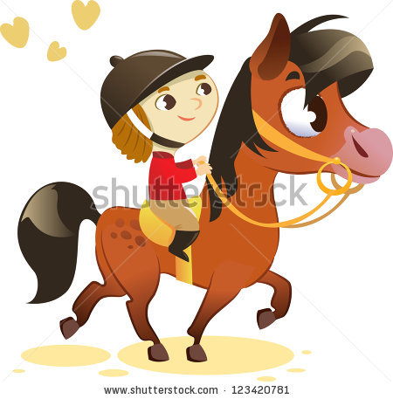
New is 2019!
3 new Disciplines!!
Gymkhana
Western Dressage
Western Trail
(Rulebooks coming)

Slide 8
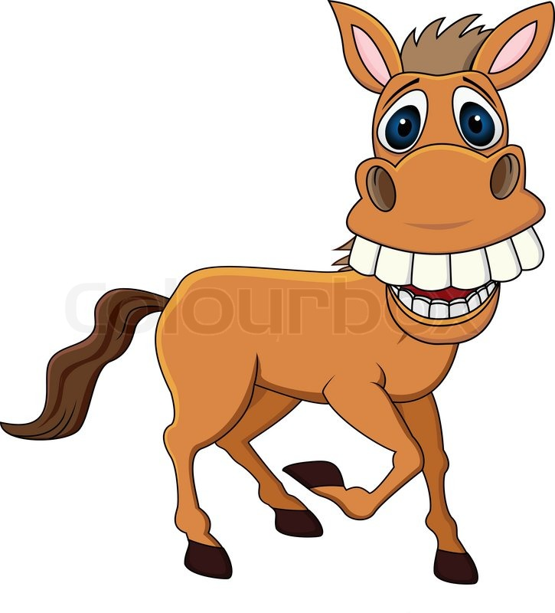
USPC Championship Changes
Now will have two Championship Divisions:
Championship Divisions
Modified Championship Divisions
Each division has their own eligibility requirements
NO exceptions to Age and rating requirements
Exceptions are for other situations (i.e. horse substitution, college student, etc.)
Notes:
Modified Championships and Championships Divisions housed in same barn and sorted by rows.
Will share HM, TD, Scoring, Show Office Officials
CHANGES CAN BE SCARY!
BUT
ARE NECESSARY!
NO RISK---NO GAIN!

Slide 9
Differences between Championships and Modified Championships
In HM Judging:
Championships Division: Come ready to show HM skills, no education.
Education sessions optional
Modified Champ Division: HM staff allow more time for education. HM can show demos, help and have active role in fixing issues. Teams are still judged and receive points, but difference is HM will take time to educate, show how to corrections and help if needed.
Education sessions require attendance
Fewer rides
Ribbons to both but slightly different in size
Swag to Championship Division only

Slide 10
USPC Championship Disciplines and How to Become Eligible
Note: These may have some changes as the activity committees are finalizing their newsletters. Be sure to check newsletters and rulebooks for any changes!
Level | Division | Minimum Age and Certification | Eligibility Requirements 12 months preceding closing date | If no Standard Regional Rally is available in discipline. | If no Modified Region Rally is available in discipline.
Dressage
Training | Modified Championships | 10 years of age & D - 2 DR/EV/Flat/HSE | Participate in a Standard Regional Dressage Rally. Earn a minimum score of 55% on Test 2 at level. | Participate in a Modified Regional Dressage Rally. Earn a minimum score of 55% on Test 2 at level. | Earn a minimum score of 55% on Test 2 at the competition level at a schooling or recognized show and participate in a mounted Regional Rally as rider or SM at minimum certification level.
 | Championships | 12 years of age & C - 1 DR/EV/Flat/HSE | Complete a Standard Regional Dressage Rally. Complete Test 2, 3 and Musical Ride at level. Earn a minimum score of 60% on Test 3. | Complete Test 2, 3 and Musical Ride at the competition level at a schooling show judged by a current L- program graduate (or licensed judge), or at a USEF/USDF recognized show; earn a 60% on Test 3. Complete a mounted Regional Rally as a rider or stable manager at minimum certification level. | Not applicable
First Level & Up | Modified Championships | 10 years of age & D - 2 DR/EV/Flat/HSE | Participate in a Standard Regional Dressage Rally. Earn a minimum score of 55% on Test 2 at level. | Participate in a Modified Regional Dressage Rally. Earn a minimum score of 55% on Test 2 at level. | Earn a minimum score of 55% on Test 2 at the competition level at a schooling or recognized show and participate in a mounted Regional Rally as rider or SM at minimum certification level.
 | Championships | 12 years of age & C - 1 DR/EV/Flat/HSE | Complete a Standard Regional Dressage Rally. Complete Test 2, 3 and Musical Ride at level. Earn a minimum score of 60% on Test 3. | Complete Test 2, 3 and Musical Ride at the competition level at a schooling show judged by a current L- program graduate (or licensed judge), or at a USEF/USDF recognized show; earn a 60% on Test 3. Complete a mounted Regional Rally as a rider or stable manager at minimum certification level. | Not applicable

Slide 11
Eventing
Beginner Novice | Modified Championships | 10 years of age & D - 2 EV/HSE | Participate in a Standard Regional Eventing Rally and one USEA or comparable event at the level. (without a riding elimination) | Participate in a in a Modified Regional Eventing Rally and one USEA or comparable event at the level. (without a riding elimination)
 | Championships | 12 years of age & C - 1 EV/HSE | Complete a Standard Regional Eventing Rally and one USEA or comparable event with no more than 20 XC penalty points at level. | Complete two USEA or comparable events with no more than 20 XC penalty points and complete a mounted Standard Regional Rally as a rider at the minimum certification level and prove Vet Box knowledge.
Novice | Modified Championships | 10 years of age & D - 2 EV/HSE | Participate in a Standard Regional Eventing Rally and one USEA or comparable event at the level. | Participate in a in a Modified Regional Eventing Rally and one USEA or comparable event at the level. (without a riding elimination)
 | Championships | 12 years of age & C - 1 EV/ HSE | Complete Standard Regional Eventing Rally and one USEA or comparable event with no more than 20 XC penalty points at the level. | Complete two USEA or comparable events with no more than 20 XC penalty points and complete a mounted Standard Regional Rally as a rider at the minimum certification level and prove Vet Box knowledge.
Training | Modified Championships | 10 years of age & D - 2 EV/HSE | Participate in a Standard Regional Eventing Rally and two USEA or comparable events at the level. (without a riding elimination) | Participate in a in a Modified Regional Eventing Rally and two USEA or comparable events at the level. (without a riding elimination)
 | Championships | 12 years of age & C - 1 EV/HSE | Complete Standard Regional Eventing Rally and two USEA or comparable events with no more than 20 XC penalty points at the level. (18 months to complete) | Complete three USEA or comparable events with no more than 20 XC penalty points and complete a mounted Standard Regional Rally as a rider at the minimum certification level and prove Vet Box knowledge. (18 months to complete)
Preliminary | Championships | 14 years of age & C - 1 EV/HSE | Complete Standard Regional Eventing Rally and two USEA or comparable events with no more than 20 XC penalty points at the level. (18 months to complete) | Complete three USEA or comparable events with no more than 20 XC penalty points and complete a mounted Standard Regional Rally as a rider at the minimum certification level and prove Vet Box knowledge. (18 months to complete)

Slide 12
Games
Novice Team | Modified Championships | 10 – 14 years of age & D - 2 DR/EV/Flat/HSE | Participate in a Standard Regional Games Rally at level. | Participate in a Modified Regional Games Rally at level.
 | Championships | 12 – 14 years of age & C - 1 DR/EV/Flat/HSE | Complete a Standard Regional Games Rally at level.
Junior Team | Modified Championships | 15 - 17 years of age & D - 2 DR/EV/Flat/HSE | Participate in a Standard Regional Games Rally at level. | Participate in a Modified Regional Games Rally at level.
 | Championships | 15 - 17 years of age & C - 1 DR/EV/Flat/HSE | Complete a Standard Regional Games Rally at level.
Senior Pairs | Modified Championships | 18+ years of age & D - 2 DR/EV/Flat/HSE | Participate in a Standard Regional Games Rally at level. | Participate in a Modified Regional Games Rally at level.
Advanced Pairs | Championships | 18+ years of age & C - 1 DR/EV/Flat/HSE | Complete a Standard Regional Games Rally at level.

Slide 13
Polocrosse
Novice | Modified Championships | 10 years of age & D - 2 DR/EV/Flat/HSE | Participate in a Standard Regional Polocrosse Rally at level. | Participate in a Modified Regional Polocrosse Rally at the competition level. | Participate in an APA play-day or tournament at competition level and participate in a mounted Regional Rally as a rider at the minimum HM certification level.
 | Championships | 10 years of age & C - 1 DR/EV/Flat/HSE | Complete a Standard Regional Polocrosse Rally at level. | Compete in an APA sanctioned Tournament at the competition level and participate in a mounted Standard Regional Rally as a rider at the minimum HM certification level. | Not Applicable
Intermediate | Modified Championships | 10 years of age & D - 2 DR/EV/Flat/HSE | Participate in a Standard Regional Polocrosse Rally at level. | Participate in a Modified Regional Polocrosse Rally at level. | Participate in an APA play-day or tournament at competition level and participate in a mounted Regional Rally as a rider at the minimum HM certification level.
 | Championships | 12 years of age & C - 1 DR/EV/Flat/HSE | Compete in a Standard Regional Polocrosse Rally at level. | Compete in an APA sanctioned Tournament at the competition level and participate in a mounted Standard Regional Rally as a rider at the minimum HM certification level. | Not Applicable
Advanced | Championships | 12 years of age & C - 1 DR/EV/Flat/HSE | Compete in a Standard Regional Polocrosse Rally at level. | Compete in an APA sanctioned Tournament at the competition level and participate in a mounted Standard Regional Rally as a rider at the minimum HM certification level. | Not Applicable

Slide 14
Quiz
Novice D | Modified Championships | 10 – 11 years of age & D – 2 HM | Participate in a Standard Regional Quiz Rally at level. | Participate in a Modified Regional Quiz Rally at rally at level. | Not Applicable
Novice C | Modified Championships | 10 – 11 years of age & C – 1 HM | Participate in a Standard Regional Quiz Rally at level. | Participate in a Modified Regional Quiz Rally at rally at level. | Not Applicable
Junior D | Championships | 12 – 17 years of age & D – 3 HM | Participate in a Standard Regional Quiz Rally at level. | Participate in a Modified Regional Quiz Rally at rally at level. | Not Applicable
Senior D | Championships | 18 + years of age & D – 3 HM | Participate in a Standard Regional Quiz Rally at level. | Participate in a Modified Regional Quiz Rally at rally at level. | Not Applicable
Junior C | Championships | 12 – 17 years of age & C – 1 HM | Participate in a Standard Regional Quiz Rally at level. | Not Applicable | Not Applicable
Senior C | Championships | 18 + years of age & C – 1 HM | Participate in a Standard Regional Quiz Rally at level. | Not Applicable | Not Applicable
H-B/H/H-A | Championships | 14 + years of age & H – B HM | Participate in a Standard Regional Quiz Rally at level. | Not Applicable | Not Applicable

Slide 15
Show Jumping
Introductory | Modified Championships | 10 years of age & D - 2 EV/HSE | Participate in a Standard Regional Show Jumping Rally. Complete a minimum of 2 rounds at the level with 24 or fewer jumping faults and not be eliminated in either round. | Participate in a Modified Regional Show Jumping Rally. Complete a minimum of 2 rounds at the level with 24 or fewer jumping faults and not be eliminated in either round. | Not Applicable
 | Championships | 12 years of age & C - 1 EV/HSE | Complete a Standard Regional Show Jumping Rally. Complete 3 rounds at the level with 12 or fewer jumping faults and no eliminations in the designated qualifying rounds. | Not Applicable | Not Applicable
DHR | Modified Championships | 10 years of age & D - 2 EV/HSE | Participate in a Standard Regional Show Jumping Rally. Complete a minimum of 2 rounds at the level with 24 or fewer jumping faults and not be eliminated in either round. | Participate in a Modified Regional Show Jumping Rally. Complete a minimum of 2 rounds at the level with 24 or fewer jumping faults and not be eliminated in either round. | Not Applicable
 | Championships | 12 years of age & C - 1 EV/HSE | Complete a Standard Regional Show Jumping Rally. Complete 3 rounds at the level with 12 or fewer jumping faults and no eliminations in the designated qualifying rounds. | Not Applicable | Not Applicable
Advanced | Championships | 12 years of age & C - 1 EV/HSE | Complete a Standard Regional Show Jumping Rally. Complete 3 rounds at the level with 12 or fewer jumping faults and no eliminations in the designated qualifying rounds. | Not Applicable | Not Applicable

Slide 16
Tetrathlon
Pre-Novice | Modified Championships | 10 – 11 years of age & D - 2 EV/HSE | Participate in a Standard Regional Tetrathlon Rally at level. | Participate in a Modified Regional Tetrathlon Rally at level.
Novice | Modified Championships | 12 – 13 years of age & D – 2 EV/HSE | Participate in a Standard Regional Tetrathlon Rally at level. | Participate in a Modified Regional Tetrathlon Rally at level.
 | Championships | 12 – 13 years of age & C – 1 EV/HSE | Complete a Standard Regional Tetrathlon Rally at level; earn a total minimum score of 2600 and a minimum score of 550 in the riding phase. | Complete a Modified Regional Tetrathlon Rally at level; earn a total minimum score of 2600 and a minimum score of 550 in the riding phase and participate in another mounted Standard rally as a rider as a C1HM
Intermediate | Modified Championships | 14 – 15 years of age & D – 2 EV/HSE | Participate in a Standard Regional Tetrathlon Rally at level. | Participate in a Modified Regional Tetrathlon Rally at level.
 | Championships | 14 – 15 years of age & C – 1 EV/HSE | Complete a Standard Regional Tetrathlon Rally at level; earn a total minimum score of 2600 and a minimum score of 550 in the riding phase. | Not Applicable
Junior | Modified Championships | 16 – 17 years of age & D – 2 EV/HSE | Participate in a Standard Regional Tetrathlon Rally at level. | Participate in a Modified Regional Tetrathlon Rally at level.
 | Championships | 16 – 17 years of age & C – 1 EV/HSE | Complete a Standard Regional Tetrathlon Rally at level; earn a total minimum score of 2800 and a minimum score of 550 in the riding phase. | Not Applicable
Senior | Modified Championships | 18 + years of age & D – 2 EV/HSE | Participate in a Standard Regional Tetrathlon Rally at level. | Participate in a Modified Regional Tetrathlon Rally at level.
 | Championships | 18 + years of age & C – 1 EV/HSE | Complete a Standard Regional Tetrathlon Rally at level; earn a total minimum score of 2800 and a minimum score of 550 in the riding phase. | Not Applicable

Slide 17
Western Dressage
Basic | Modified Championships | 10 years of age & D - 2 DR/EV/Flat/HSE/WST | Earn a minimum score of 55% on Test 2 at level at a Standard Regional Dressage Rally. | Participate in a Modified Regional Dressage Rally. Earn a minimum score of 55% on Test 2 at level. | If no modified regional rally available in discipline. Complete Test 2 at the competition level at a recognized dressage show or a schooling show with a WD “r” judge and earn a minimum score of 55% on Test 2 and a mounted regional rally as a rider or stable manager at the minimum HM certification level.
 | Championships | 12 years of age & C - 1 DR/EV/Flat/HSE/WST | Complete Test 2, 3 and Musical Ride at level at a Standard Regional Dressage Rally. Earn a minimum score of 60% on Test 3. | Complete Test 2,3 and Musical Ride at level at a show with an WD ‘r’ judge and earn a 60% on Test 3. Complete a mounted Regional Rally as rider or SM at minimum certification level. | Not Applicable
Level 1 & Up | Modified Championships | 10 years of age & D - 2 DR/EV/Flat/HSE/WST | Earn a minimum score of 55% on Test 2 at level at a Standard Regional Dressage Rally. | Participate in a Modified Regional Dressage Rally. Earn a minimum score of 55% on Test 2 at level. | If no modified regional rally available in discipline. Complete Test 2 at the competition level at a recognized dressage show or a schooling show with a WD “r” judge and earn a minimum score of 55% on Test 2 and a mounted regional rally as a rider or stable manager at the minimum HM certification level.
 | Championships | 12 years of age & C - 1 DR/EV/Flat/HSE/WST | Complete Test 2, 3 and Musical Ride at level at a Standard Regional Dressage Rally. Earn a minimum score of 60% on Test 3. | Complete Test 2,3 and Musical Ride at level at a show with an WD ‘r’ judge and earn a 60% on Test 3. Complete a mounted Regional Rally as rider or SM at minimum certification level. | Not Applicable

Slide 18
Changes with Champ Entry
Entry system is being totally updated.
Changes:
Parents/competitors are to complete entries themselves
To submit MUST have all info complete
Looking into being able to upload or otherwise submit coaches, chaperone and coggins forms.
Have to pay to submit (Looking into how to make this flexible as to who pays)
MUST have volunteer identified to submit
Once submitted will go to RS or designated Regional Contact
Region composes teams
RS or designated Regional Contact submits teams to National and discipline secretary
RS or designated Regional Contact submits needed discipline paperwork to discipline secretary.
Paperwork is encouraged to be submitted online. Snail mail accepted, but if mailed on July 1 must be overnighted.

Slide 19
NEW RULEBOOKS!
Now each discipline will have 3 Books:
Rulebook (out now)
Organizer Guide (working on)
Educational Handbook (working on)

Slide 20
Changes in Rulebooks for 2019
Uniformity: All Rulebooks look and are organized in the same format
READ THEM!!!
Table of Contents
SECTIONI: USPC Rally Uniform Officiation Rules (UOR)
SECTION II: General Regulations
Chapter 1—Team Composition
Chapter 2—Competition Levels and Divisions
Chapter 3—Presentation of Competitor and Mount
(All in Blue are the same is EVERY Rulebook….read one you read all!)
SECTIION III: Competition
SECTION IV: Scoring
SECTION V: Oﬃciation
SECTION VI: Appendices
Resource List

